Slide 1

Prediction of stock value changes based on the sentiment analysis of news headlines
Bachelor of Technology
in
Computer Science and Engineering
By
DEVESH KUMAR SHARMA (Reg No. 2018105172)
V VENYI NUKHU (Reg No. 2018105189)
Under guidance of Dr. ARAMBAM NEELIMA
DEPARTMENT OF COMPUTER SCIENCE AND ENGINEERING
NATIONAL INSTITUTE OF TECHNOLOGY NAGALAND
CHUMUKEDIMA, DIMAPUR 797 103

Slide 2
Contents:
Problem Statement
Objective
Literature Review
Proposed Model
Work Done
Exploratory Data Analysis
Data pre-processing
Bag of words
Decision Tree Classifier
Random Forest Classifier
Passive Aggressive Classifier
Support Vector Machine
Multinomial naïve bayes classifier
Comparison of different models
Insights from the comparison
Grouping of Words
Conclusion
Future Scope
References

Slide 3
Problem Statement
Predicting the future stock trend with news sentiment classification based on the financial news articles.
Due to the rapid changes or fluctuations of stock price depends on the gains and losses of certain companies. News articles are on of the most important factors which will influence the stock market.
This project is about taking non quantifiable data such as financial news articles about a company and predicting its future stock trend with news sentiment classification. Assuming that news articles have impact on stock market, an attempt to study the relationship between news and stock trend will be carried out.

Slide 4
Objective
The main objective of this project is to enhance the current accuracy of the existing model.
This can be done through better text-to-vector transformation i.e. bag of words.
Thereafter performing 5-Cross validation or 10-Cross validation for testing the different models.
The secondary objective is to decrease the training time of the Multinomial Naïve Bayes Theorem classifier.

Slide 5
Literature Review
Nagar and Hahsler in their research [1] presented an automated text mining-based approach to aggregate news stories from various sources and create a News Corpus. The Corpus is filtered down to relevant sentences and analysed using Natural Language Processing (NLP) techniques.
A sentiment metric, called News Sentiment, utilizing the count of positive and negative polarity words is proposed as a measure of the sentiment of the overall news corpus.
They have used various open-source packages and tools to develop the news collection and aggregation engine as well as the sentiment evaluation engine. They also state that the time variation of News Sentiment shows a very strong correlation with the actual stock price movement.
Yu et al [2] present a text mining-based framework to determine the sentiment of news articles and illustrate its impact on energy demand. News sentiment is quantified and then presented as a time series and compared with fluctuations in energy demand and prices.

Slide 6
Continued…
J. Bean [3] uses keyword tagging on Twitter feeds about airlines satisfaction to score them for polarity and sentiment. This can provide a quick idea of the sentiment prevailing about airlines and their customer satisfaction ratings.
This research paper [4] studies how the results of financial forecasting can be improved when news articles with different levels of relevance to the target stock are used simultaneously.
They used multiple kernels learning technique for partitioning the information which is extracted from different five categories of news articles based on sectors, sub-sectors, industries, etc.
News articles are divided into the five categories of relevance to a targeted stock, its sub-industry, industry, group industry, and sector while separate kernels are employed to analyse each one.
The experimental results show that the simultaneous usage of five news categories improves the prediction performance in comparison with methods based on a lower number of news categories.

Slide 7
Proposed Model
EDA and Data Visualization
Total Data points
Negative/Positive Sentiments
Data Preprocessing
Removing Punctuations
Converting to Lower Case
Construction of Bag of Words
Sentence to Vector
Modified Multinomial Naïve Bayes
Taking input of two words
Testing the Model
K-fold cross validation
Accuracy
Joining all 25 Headlines

Slide 8
Work Done
EDA and Data Visualization
Data Preprocessing
Construction of Bag of words
Implementation of Decision Tree Classifier
Implementation of Random Forest Classifier

Slide 9
Continued…
Implementation of Passive Aggressive Classifier
Implementation of Support Vector Machine
Implementation of Multinomial Naïve Bayes Classifier
Implementation of Modified Multinomial Naïve Bayes Classifier
Applying 5 cross validation and 10 cross validation for testing the model
Comparing the models based on different parameters

Slide 10
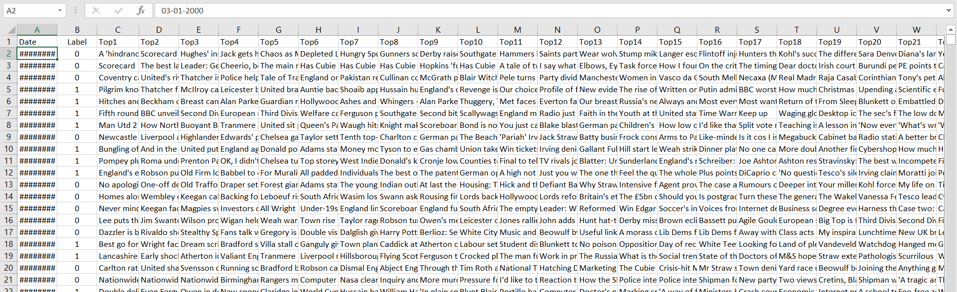
Dataset

Slide 11
Exploratory Data Analysis
Visualizing the data.
Label value count.
Total number of data points.

Slide 12
Data Preprocessing
Removing punctuations from the news headlines.
Renaming column names for ease of access.
Converting headlines to lowercase.
Joining all the top 25 news headlines to a single sentence.
Splitting the training and testing data.

Slide 13
Bag of words
Bag of words:
Sent1 – Amazon is a good company
Sent2 – Microsoft is better than Amazon
Sent3 – Amazon and Microsoft are good company
Sent1 | Amazon | Good | Company
Sent2 | Microsoft | Better | Amazon
Sent3 | Amazon | Microsoft | Good | Company
Word | Frequency
Amazon | 3
Microsoft | 2
Good | 2
Company | 2
Better | 1
 | Amazon | Microsoft | Good | Company | Better
Sent1 | 1 | 0 | 1 | 1 | 0
Sent2 | 1 | 1 | 0 | 0 | 1
Sent3 | 1 | 1 | 1 | 1 | 0

Slide 14
Decision Tree Classifier
Decision Tree is a Supervised learning technique that can be used for both classification and Regression problems, but mostly it is preferred for solving Classification problems. It is a tree-structured classifier, where internal nodes represent the features of a dataset, branches represent the decision rules and each leaf node represents the outcome.
In a Decision tree, there are two nodes, which are the Decision Node and Leaf Node. Decision nodes are used to make any decision and have multiple branches, whereas Leaf nodes are the output of those decisions and do not contain any further branches.
The decisions or the test are performed on the basis of features of the given dataset.
It is a graphical representation for getting all the possible solutions to a problem/decision based on given conditions.

Slide 15
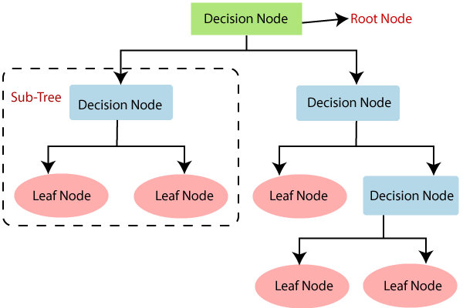
Continued…

Slide 16
Random Forest Classifier
Random Forest is a popular machine learning algorithm that belongs to the supervised learning technique. It can be used for both Classification and Regression problems in ML.
Random Forest is a classifier that contains a number of decision trees on various subsets of the given dataset and takes the average to improve the predictive accuracy of that dataset.
Instead of relying on one decision tree, the random forest takes the prediction from each tree and based on the majority votes of predictions, and it predicts the final output.

Slide 17
Continued…

Slide 18
Passive Aggressive Classifier
Passive-Aggressive algorithms are generally used for large-scale learning. It is one of the few ‘online-learning algorithms‘. In online machine learning algorithms, the input data comes in sequential order and the machine learning model is updated step-by-step, as opposed to batch learning, where the entire training dataset is used at once.
This is very useful in situations where there is a huge amount of data and it is computationally infeasible to train the entire dataset because of the sheer size of the data. We can simply say that an online-learning algorithm will get a training example, update the classifier, and then throw away the example.

Slide 19
How Passive-Aggressive Works:
Passive-Aggressive algorithms are called so because :
Passive :
If the prediction is correct, keep the model and do not make any changes. i.e., the data in the example is not enough to cause any changes in the model.
Aggressive :
If the prediction is incorrect, make changes to the model. i.e., some change to the model may correct it.

Slide 20
Support Vector Machine
Support Vector Machine or SVM is one of the most popular Supervised Learning algorithms, which is used for Classification as well as Regression problems. However, primarily, it is used for Classification problems in Machine Learning.
The goal of the SVM algorithm is to create the best line or decision boundary that can segregate n-dimensional space into classes so that we can easily put the new data point in the correct category in the future. This best decision boundary is called a hyperplane.
SVM chooses the extreme points/vectors that help in creating the hyperplane. These extreme cases are called as support vectors, and hence algorithm is termed as Support Vector Machine. Consider the below diagram in which there are two different categories that are classified using a decision boundary or hyperplane:

Slide 21
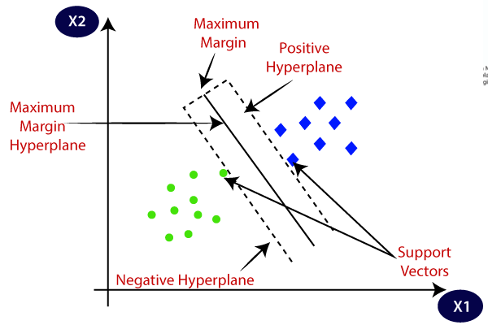
Continued…

Slide 22
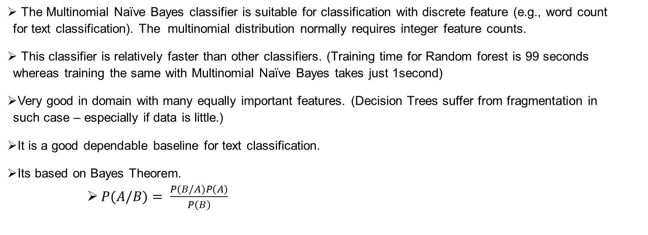
Multinomial Naïve Bayes Classifier
The Multinomial Naïve Bayes classifier is suitable for classification with discrete feature (e.g., word count for text classification). The multinomial distribution normally requires integer feature counts.
This classifier is relatively faster than other classifiers. (Training time for Random forest is 99 seconds whereas training the same with Multinomial Naïve Bayes takes just 1second)
Very good in domain with many equally important features. (Decision Trees suffer from fragmentation in such case – especially if data is little.)
It is a good dependable baseline for text classification.
Its based on Bayes Theorem.
              $P(A/B)= \frac{P(B/A)P\left(A\right)}{P\left(B\right)}$

Slide 23
Continued…
The term Multinomial Naive Bayes simply lets us know that each p(f_{i} / c) is a multinomial distribution, rather than some other distribution. This works well for data which can easily be turned into counts, such as word counts in text.
The distribution we had been using with Naive Bayes classifier is a Gaussian distribution, so I guess we could call it a Gaussian Naive Bayes classifier.
In summary, Naive Bayes classifier is a general term which refers to conditional independence of each of the features in the model, while Multinomial Naive Bayes classifier is a specific instance of a Naive Bayes classifier which uses a multinomial distribution for each of the features.

Slide 24
Comparison of different models:
Model | Training Time(sec) | Accuracy % (accuracy_score) (count of correct predictions)
Decision Tree Classifier | 108.233363151550 | 49.20634920634920
Random Forest Classifier | 90.2992811203003 | 84.65608465608465
Passive Aggressive Classifier | 0.35799646377563 | 85.44973544973545
Support Vector Machine | 66.0001437664032 | 50.79365079365079
Multinomial Naive Bayes Classifier | 0.12466573715209 | 85.41973123973545
Modified Multinomial Naive Bayes Classifier | 0.12436687546542 | 51.23654944356875
Comparing different models based on parameters such as training time and accuracy

Slide 25
Insights from comparison
Training time of Multinomial Naïve Bayes and Passive Aggressive Classifier was found relatively low compared to other models.
Whereas Training time of Random forest, Decision Tree, and Support Vector Machine have a better scope to be improved.
Accuracy of Passive aggressive classifier, Random forest classifier and Multinomial classifier was found to be good enough and best as per our use case(Stock Sentiment).

Slide 26
Continued…
We have found out that Multinomial Naïve Bayes takes the word and gives it a value which is further used to calculate the sentiment of a particular headline.
But it does not account for words who have a greater impact when grouped together i.e. “not good” will be treated as “not” and “good” but it has similar meaning as “bad”.
We have tried to make an adaptive Multinomial Naïve Bayes classification model which can group two words who have a greater meaning together when calculating the probability of a sentence.

Slide 27
Grouping of words :
Scenario -1 Scenario - 2
Hi
Market
Hi Book
Market Price
Book
Price
No Meaning when two words are combined
There is some greater meaning when two words are combined

Slide 28
Grouping of words :
Scenario -1 Scenario - 2
News1 - The Investors are selling their stocks.
News 2 – Today is wormer than yesterday.
Investors selling stocks
Today warmer yesterday
Investors-selling
stocks
Investors
selling-stocks
Today-warmer
yesterday
Today
Warmer-yesterday
There is some greater meaning when two words are combined
Not a good combination of words since they don’t convey meaning

Slide 29
How a word is positive/negative sentiment
Let us take an example of a negatively marked and positively marked sentence:
  Amazon does a lot of frauds while delivery. → negative
  Flipkart delivery service is fast. → positive
  Now if we consider the first sentence then :
    It will learn to associate the following words Amazon, does, lot, frauds, while, and delivery all as negative sentiments.
    Obviously we don’t want Amazon or delivery or lot to be in negative sentiment, so unlearning this will require training set instances with the word Amazon, delivery or lot in them that are labeled as positive.
  In the second sentence delivery is a positive sentiment word.

Slide 30
Conclusion
From the above block diagram we can conclude the following :
We have got an accuracy of 51.23% for the model.
We got to know that when we combined 2 words then words having no meaning were more as compared to the number of words that have a greater meaning when combined together.
For now we merged only two words together but we can have a future scope of combining more than 2 words that have a greater impact as a whole.

Slide 31
Future Scope
Optimizing the grouping of words in a more optimal manner according to their meaning.
Enhancing the adaptive model to achieve better accuracy.
Further optimizing the model for even better overall performance in terms of accuracy, time of training and in also when the model is working on real time data.

Slide 32
References
[1] Anurag Nagar, Michael Hahsler, Using Text and Data Mining Techniques to extract Stock Market Sentiment from Live News Streams, IACSIT Press, Singapore, IPCSIT vol. 20 2012.
[2] W.B. Yu, B.R. Lea, and B. Guruswamy, A Theoretic Framework Integrating Text Mining and Energy Demand Forecasting, International Journal of Electronic Business Management. 5(3): 211-224, 2011.
[3] J. Bean, R by example: Mining Twitter for consumer attitudes towards airlines, In Boston Predictive Analytics Meetup Presentation, 2011
[4] Yauheniya Shynkevich, T.M. McGinnity, Sonya Coleman, Ammar Belatreche, Predicting Stock Price Movements Based on Different Categories of News Articles, 2015 IEEE Symposium Series on Computational Intelligence, 2015
[5] J. Griffith, M. Najand and J. Shen, "Emotions in the Stock Market", J. Behav. Financ., vol. 21, no. 1, pp. 42-56, Jan. 2020.
[6] O. C. Sert, S. D. Şahin, T. Özyer and R. Alhajj, "Analysis and prediction in sparse and high dimensional text data: The case of Dow Jones stock market", Phys. A Stat. Mech. its Appl., vol. 545, pp. 123752, 2020.
[7] Sandipan Biswas, Shivnath Ghosh, “A Comparative Study into Stock Market Prediction Through Various Sentiment Analysis Algorithms”, pp 117-128 29 September 2021.

Slide 33
Thank You

